Slide 1


SRU WISDOM LEARNING -WEBSITE
Project Team-39
Chiluka Nanda Sai 2203A51L76
Kondra Rishitha 2203A51L84
Pittala Lokesh kumar 2203A51L70
Yellapati Srinitha Reddy 2203A51L68

Slide 2

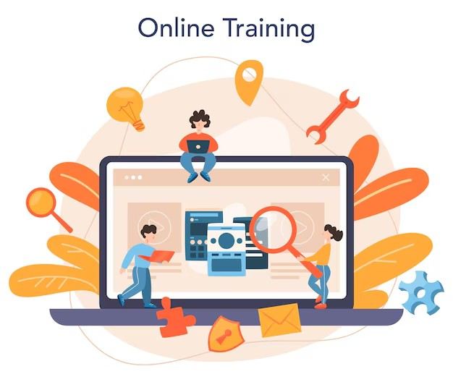
SRU Wisdom Learning -Website
SRU Wisdom is a comprehensive online learning platform designed to provide a dynamic and engaging space for users to access a wide range of educational resources and tools. The project is driven by a commitment to make quality education more accessible, breaking down barriers and empowering learners of all backgrounds to pursue their intellectual passions.
Through interactive lessons, multimedia content, and personalized learning pathways, Sru Wisdom aims to deliver an immersive and transformative educational experience. The project team is dedicated to continuous innovation and platform refinement to meet the evolving needs of modern learners.

Slide 3

Abstract
Overview
SruWisdom aims to bridge the gap between traditional learning and modern technology
Goal
SruWisdom will provide accessible and engaging educational resources
Scope
This project will focus on creating a user-friendly platform with a range of interactive features.

Slide 4
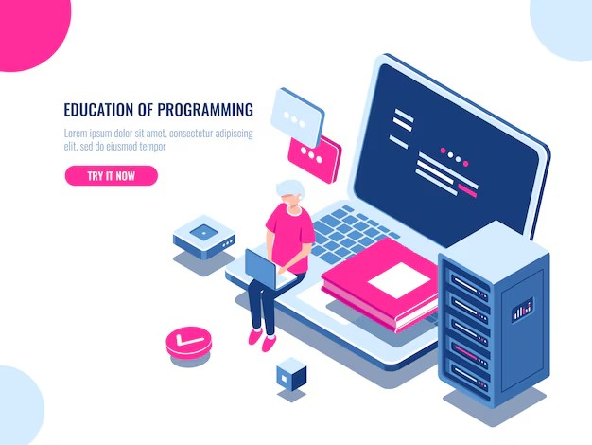
Introduction
The Need: With the increasing demand for accessible online learning resources, there’s a gap in providing flexible, engaging, and high-quality educational tools that cater to various learning styles.
The Solution: SruWisdom addresses this by offering a user-friendly platform designed to meet diverse educational needs. It provides an interactive and personalized learning experience, ensuring learners of all ages and backgrounds can access quality education anytime, anywhere.
Target Audience: The platform is designed for a broad range of learners, including students seeking academic knowledge, professionals aiming to upskill, and lifelong learners who want to explore new areas of interest. The inclusive nature of SruWisdom ensures it’s suitable for learners of all age groups, from beginners to advanced learners.

Slide 5

Problem Identification
Limited Access:
Many individuals, especially in underprivileged areas, struggle to access high-quality educational resources due to factors like geographical barriers, lack of infrastructure, or unavailability of local institutions that provide diverse educational programs.
Lack of Engagement:
Traditional education methods can be passive, relying heavily on one-way content delivery (e.g., lectures and textbooks). This often fails to capture the learner’s attention or stimulate active participation, leading to disengagement or ineffective learning.
Cost Barriers:
Formal education, especially in traditional institutions, often comes with high costs such as tuition fees, materials, and other associated expenses. This financial burden can prevent many potential learners from pursuing their educational goals.

Slide 6

Defining Objectives
Accessibility
The platform aims to make learning resources widely available, breaking down barriers to education and reaching a larger audience, including those who might lack access to traditional educational resources.
Engagement
The objective is to develop interactive features that actively involve users in the learning process, enhancing their experience and promoting active learning as opposed to passive consumption.
Affordability
SruWisdom seeks to provide a cost-effective alternative to traditional education, making quality education more affordable for individuals who face financial constraints​

Slide 7

Literature Review
Research
A thorough investigation was conducted into existing online learning platforms and effective strategies for engaging users. This research serves as the foundation for the platform's design and interactive features.
Best Practices
The team analyzed successful online learning platforms to identify best practices. These practices were integrated into the platform's development to ensure a high-quality learning experience.
Trends
The review also highlighted the latest trends in educational technology and pedagogy. These trends informed design decisions, ensuring the platform remains innovative and aligned with modern educational needs​(SruWisdom-Learning-Webs…).

Slide 8

Existing Methods
MOOCs (Massive Open Online Courses)
These offer free or low-cost courses, allowing a large number of people to access education. They are a widespread method for providing accessible learning.
Learning Management Systems (LMS)
LMS platforms are used for course delivery, tracking progress, and assessing learners. They serve as a structure for organizing and managing online education.
Online Tutors
Personalized instruction through video chats or messaging services is another key method, providing learners with one-on-one support and a tailored educational experience​.

Slide 9

Proposed System
Interactive Videos
The system will feature video lessons with quizzes and other interactive elements embedded, ensuring that learners are actively engaged while they study.
Discussion Forums
Students will be able to interact with one another, ask questions, and share ideas through forums. This creates a sense of community and facilitates peer-to-peer learning.
Progress Tracking
Learners can monitor their progress through the platform, keeping track of their achievements and identifying areas where they need improvement.
Certification
After completing courses, learners will receive certificates, providing formal recognition of their accomplishments

Slide 10

Conclusion and Future Plans
The Conclusion and Future Plans of the SruWisdom project explain that it aims to make learning easier, more engaging, and affordable for everyone. The platform provides interactive videos, forums, and progress tracking to improve the learning experience.

